Slide 1



Laboratory Biosecurity
CPHL/MoH

Slide 2
Why Implement a Laboratory Biosecurity Program?
Improve security
Increase emergency preparedness
Protect reputation/image
Mitigate liability exposure
Protect public health
Protect employees
Protect research

Slide 3

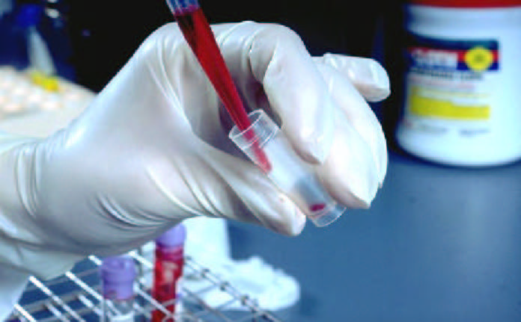
Biosecurity is a part of Biosafety Biosecurity and Biosafety are components of Good Laboratory Practice

Slide 4
Biosafety vs. Biosecurity
Biosafety: Reduce or eliminate accidental exposure of individuals and the environment to potentially hazardous biological agents
Biosecurity: The protection of pathogens, toxins, and sensitive information from loss theft and subsequent misuse

Slide 5
Biosafety vs. Biosecurity (Simply stated…)
Biosafety:
Protect people from dangerous pathogens
Limited lab access while work is in progress
Biosecurity:
Protect pathogens from dangerous people
Limit access to Labs that contain certain biological agents

Slide 6
Biosafety & Biosecurity Similarities
Biosafety and Biosecurity are complementary.
Biosecurity relies on a sound biosafety program.
Biosecurity practices reinforce and strengthen biosafety.

Slide 7
Biosecurity Objective
Protect Against:
Loss, Theft
Diversion of dangerous pathogens
Minimize intentional misuse

Slide 8
Biosecurity Strategies
Protect defined assets against defined threats
Define risk by evaluating probabilities and consequences
Integrate security technologies and procedures
Apply a graded protection approach
Impact operations only to the level required

Slide 9
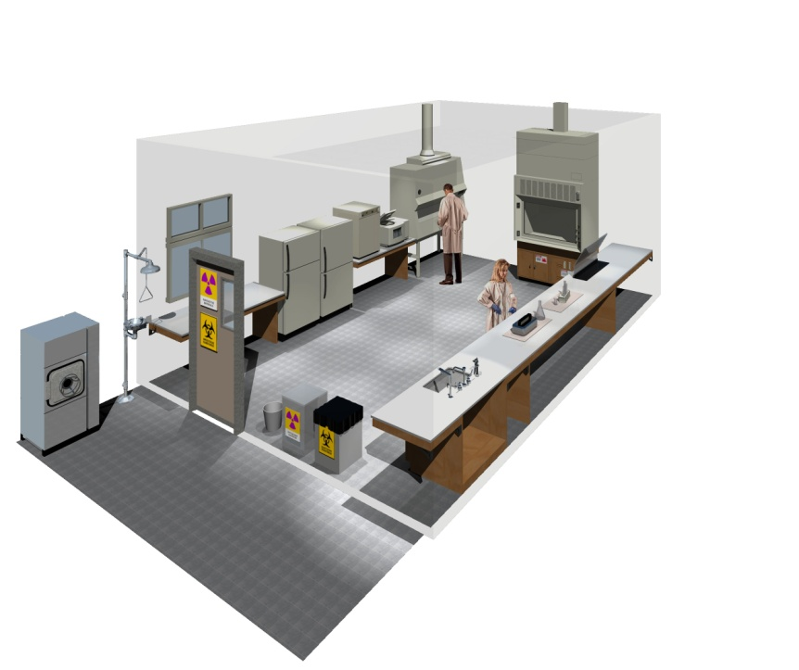
Similar Implementation Strategies
Policies and Practices
SOP
Training
Equipment
Facility Design
BSL-2

Slide 10
Biosecurity and Biosafety Overlap
Risk assessment & risk management
Personnel screening
Physical security elements
Training
Emergency planning
Management oversight

Slide 11
Biosecurity and Biosafety Overlap
Inventory and tracking of biological materials
Adoption, implementation and accountability
Shipment of infectious materials must adhere to safe packaging, documentation and transport
Good Laboratory Practices
Training on general practices, SOP, and awareness of risks and hazards
Notes:
Both biosafety and biosecurity procedures include the inventory and tracking of biological materials. Also integral to both biosafety and biosecurity is the safe packaging, accurate documentation, and transport of infectious materials. Program management should embrace laboratory safety and security as a code of practice for responsible research and operation. Senior management should ensure the adoption, implement and accountability of biosafety and biosecurity programs. In addition, these programs should be reinforced by training on general practices, specific standard operating procedures and awareness of potential risk and hazards. All of these are essential to ensuring the daily implementation of safety and security polices.

Slide 12
Biosafety and Biosecurity Conflict/Challenges
Must be resolved to accommodate both Biosafety and Biosecurity objectives.

Slide 13
Example: Emergency Response
Rapid egress of laboratorians
Emergency ingress of responders
While ensuring security of assets
Life safety measures must not allow an adversary access to biological materials by activating emergency alarm systems.

Slide 14
Example: Signage Requirements
Biohazard signage re: risks in lab list
BSL, agent, medical requirements, PPE required, contact name/ number
Listing agent may compromise security
Modify signage to disclose hazards; not to disclose specific agent(s)

Slide 15
Universality of Microbes
In nature globally
Obtainable from culture collections
Located in different types of labs in many countries
Impossible to secure all pathogens & control access
Academic Hospital Pharmaceutical Biotech | Clinical Research Veterinary Vaccine Manufacturing

Slide 16
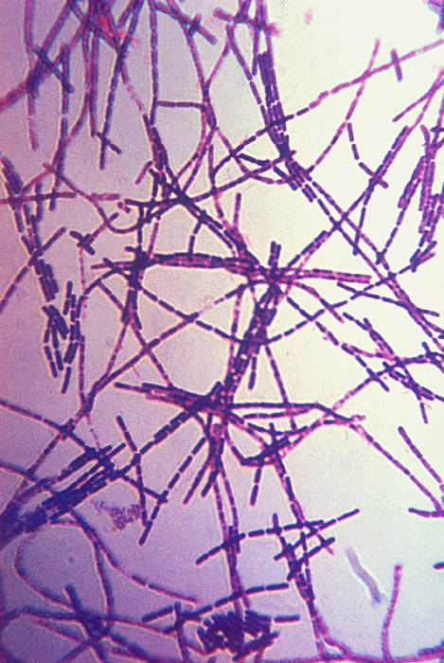
Microbiological Considerations
Infectious via aerosol
Person to person
Stable
Susceptible individuals
High morbidity and mortality
Difficult to diagnose/treat
Historically used or developed as weapons

Slide 17
Microbes Multiply
They grow, mutate
Found in the environment, animals, Petri dishes, tubes, flasks
In cell cultures, clinical specimens, animal carcasses, wastes
In incubators, freezers, refrigerators, freeze-dried forms
Safe-guarding all this is very complicated
Knowing “working” quantities impossible

Slide 18
Balancing Security with Work
Scientist may be unaccustomed to working in a security conscious environment
Security experts may want more procedures than are compatible with current projects
Strategy: Facilitate open collaboration and mutual respect to reach same goals.

Slide 19
Absolute Security Impossible
Easy to secretly or maliciously remove biologicals
Minute quantities
No stand-off detection technologies
Best strategy: tiered approach in which level of protection commensurate with level of risk and level of threat

Slide 20
Developing a Biosecurity Program
Collaboration with representatives:
Senior management
Scientific staff
Security officials
Safety personnel
Engineering staff
Information Technology (IT) staff
Human resources officials

Slide 21
Biosecurity Risk Assessment

Slide 22
Risk Assessment
Definition:
An evaluation of the probability and consequences of undesirable events caused by an adversary that could affect the defined assets.
Goal:
To determine which events the security system must be designed to protect against

Slide 23
Vulnerability Assessment
Definition:
A systematic evaluation process in which
qualitative and quantitative techniques are
applied to arrive at an effectiveness level for a
security system to protect biologic laboratories
and operations from specifically defined acts
that can oppose or harm a person's interest.
Source: MMWR, December 6, 2002 / 51(RR19);1-8

Slide 24
Risk Assessment Results
Allow management to make informed decisions to ensure that the cost of protective measures are proportional to the risk.

Slide 25
Five Step for Biosecurity Risk Assessment
1. Identify and prioritize assets
2. Assess potential threats and vulnerabilities
3. Analyze the risk of specific security scenarios
4. Design and develop an overall risk management program
5. Re-evaluate institution’s risk posture and protective objectives

Slide 26

Step 1: Identify and Prioritize Assets
Identify agents, materials, equipment, personnel
Evaluate potential misuse or weaponization
Evaluation consequence of misuse
Prioritize assets based on consequence of misuse

Slide 27
Step 2: Assess Potential Threats and Vulnerabilities
Identify types of outsiders
Identify types of insiders
Evaluate motive, means, opportunity for potential adversaries

Slide 28
Threats
Outsider
Low Risk
Public access to info
May be armed
May carry tools
Strategy:
Detect & Contain
Insider
High Risk
Unescorted access
Non-violent
Knowledge of facility
Opportunity
Strategy:
Know employees

Slide 29
Step 3: Analyze the Risk of Specific Security Scenarios
Develop list of possible security scenarios
Evaluate probability of each scenario materializing and its consequences
Prioritize or rank scenarios by risk for management to review

Slide 30
Step 3: Analyze the Risk of Specific Security Scenarios
Moderate
Risk
High
Risk
Highest
Risk
Evaluate the probability of each risk scenario materializing and its associated consequences
More Likely
Probability
Protect against unacceptable risk scenarios (Prioritize)
Lowest
Risk
Low
Risk
Moderate
Risk
Develop incident response plans for acceptable risk scenarios
Less Likely
Low
Moderate
High
Consequences

Slide 31
Step 4: Design and Develop and Overall Risk Management Program
Management:
Makes final decision on items that require protection, with advise from committee.
Oversees, implements, trains, and maintains biosecurity program
Develops “Risk Statement”
Develops “Biosecurity Plan”
Ensures resources to achieve measures in biosecurity plan

Slide 32
Step 4: Design and Develop an Overall Risk Management Program
Moderate
Risk
High
Risk
Highest
Risk
More Likely
Probability
Lowest
Risk
Low
Risk
Moderate
Risk
Less Likely
Low
Moderate
High
Consequences

Slide 33
Step 5: Re-evaluate Institution’s Risk Posture and Protection Objectives
Re-evaluate and modify:
Biosecurity risk statement
Biosecurity risk assessment process
Biosecurity program/plan
Biosecurity systems
Re-enforce:
Implementation, training, annual re-evaluation of security program.

Slide 34
Developing a Security Plan

Slide 35
Developing a Security Plan
Site specific process
Systematic approach
Involves:
Biosecurity Risk / Vulnerability Assessment
Risk Management Process & Policies
Both are critical processes
Notes:
However, best guess estimates can be made using a variety of information sourced. Each step of the procedure can be examined and various control measures can then be put into place. The guidelines and protocols that are developed become the risk management procedures for working with the specific pathogen.

Slide 36
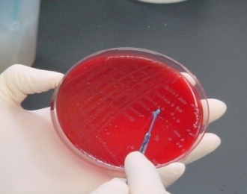
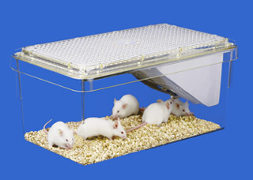
Developing a Security Plan
Institution Responsibilities:
Management commitment
Delegate program oversight
Ensure Resources & Manpower
Delegate enforcement
Ensures comprehensive “Biosecurity Program”
Development and implementation
Encompasses Laboratory and Animal programs
Integrated with facility-wide security plans
Notes:
These nine topics are covered in detail in the MMWR-RR publication.

Slide 37
Components of a Biosecurity Plan
Program Management
Physical Security and Access Control
Personnel Management
Inventory & Accountability
Information Security
Transport of Biological Material
Accidents, Injuries & Emergency Response
Reporting & Communication
Training, Practice, Drills
Updates and Re-evaluation

Slide 38
Program Management
Management Commitment
Establishes a “Culture of Responsibility”
Establish Chain-of-Command
Roles and Responsibilities
Ensure
Resources (funding)
Manpower (staffing)
Delegate enforcement authority

Slide 39
Program Management
Develops Biosecurity ‘Risk Statement”
Makes Risk Management Decision
Develops & Implements Biosecurity Plan
Written / Documented Plan with SOP’s
Tiered / Combination Approach
Commits Enforcement
Annual Evaluations

Slide 40
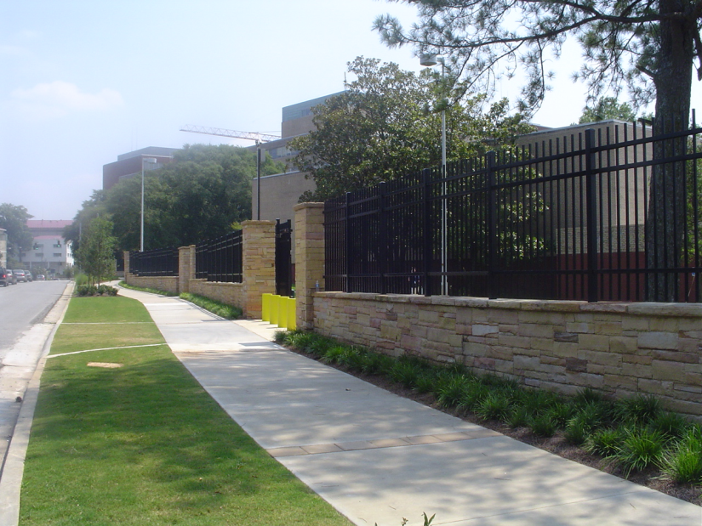
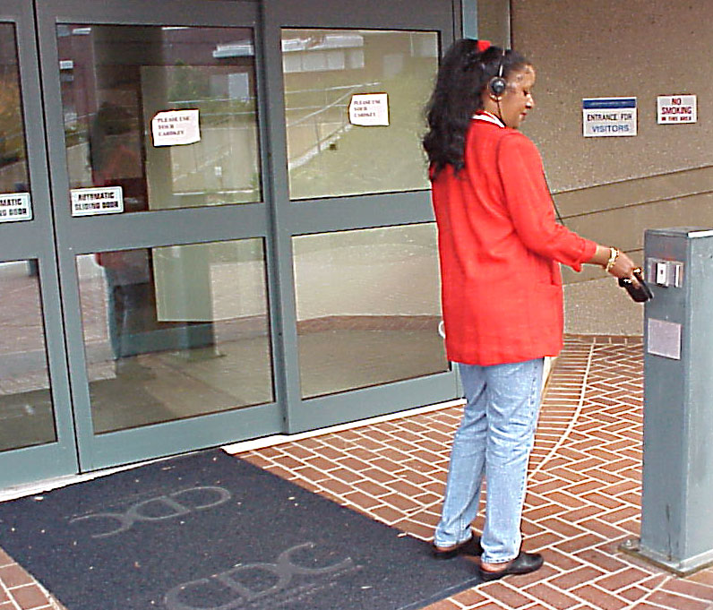
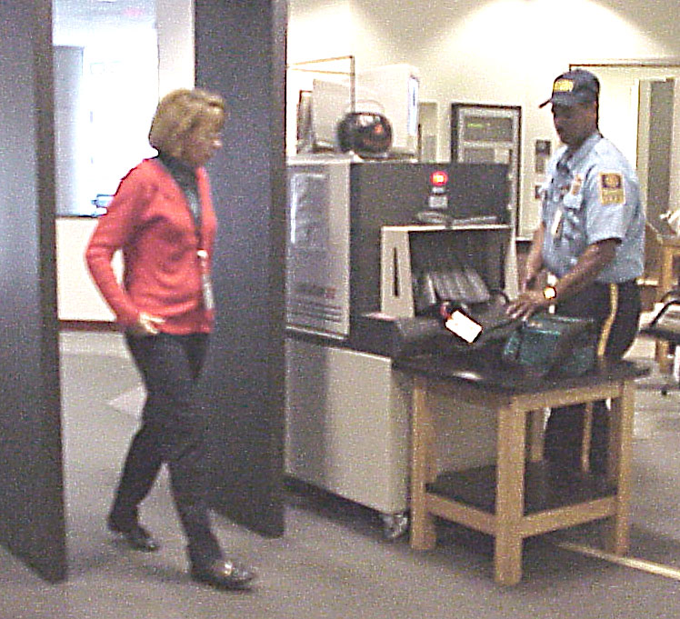
Physical Security
Notes:
At CDC, employees are admitted by card key to the campus and the parking areas, then to the gate-guarded building entrances, and finally into the interior of the buildings after passing through metal detectors.

Slide 41
Physical Security/Access Control
Prevent unauthorized material removal
Building / Laboratory / Storage Areas
Consolidate products, to extent possible
Establishes control area

Slide 42
Physical Security/Access Control (cont…)
Limits Access:
Establishes authorized personnel
Detects unauthorized entry
Considers “escorted entry” needs
Visitors, Maintenance, Emergency Staff

Slide 43
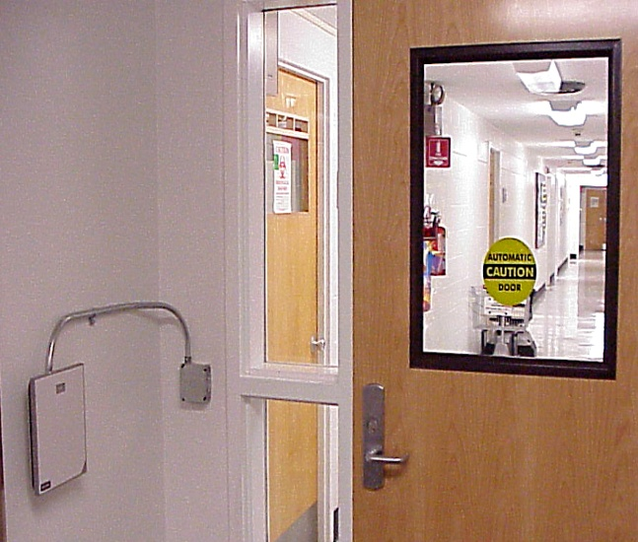
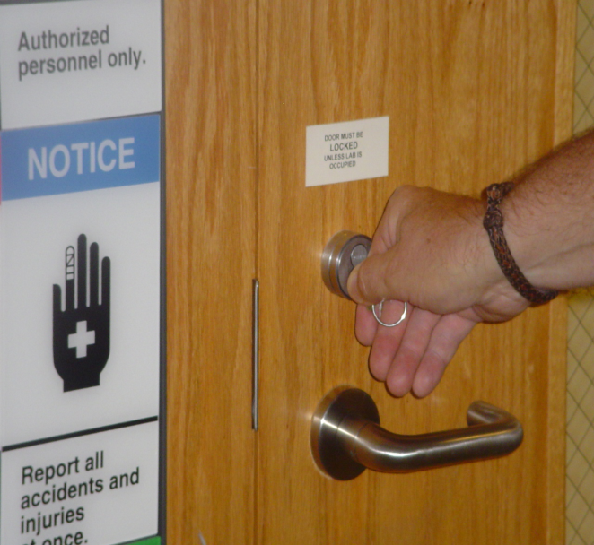
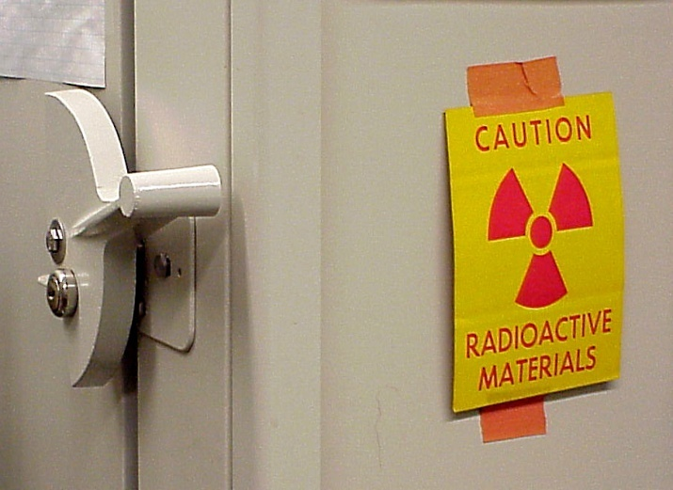
Access Controls Examples

Slide 44
Access Control Examples
Tiered or Combination Approach
Guards Fence/s
Cameras Alarms
ID Badges Manual Lock & Keys
Electronic Keys Biometrics
Alarms
Fences
Guards
Cameras
ID badges
Biometics
Manual Lock & Key

Slide 45

Personnel Management
Employee Security
Evaluates “trust level”
Integrity of individual
Good character vs. Illegal activities
Methods: Police background checks,
Credit checks, Personal references

Slide 46

Inventory and Accountability
Tracks agent
Use, Storage, Transfer, Destruction
Three “w”
Who’s = Responsible person
What = Identifies agent
Form of agent & Amount
Where = Location/s

Slide 47
Accountability (cont…)
Management defines:
What materials subject to accountability
Documentation - reporting procedures
Record keeping practices
Electronic files vs. Log books
Inventory procedures
Working stocks vs. Repository stocks
Integrated with Information Security

Slide 48
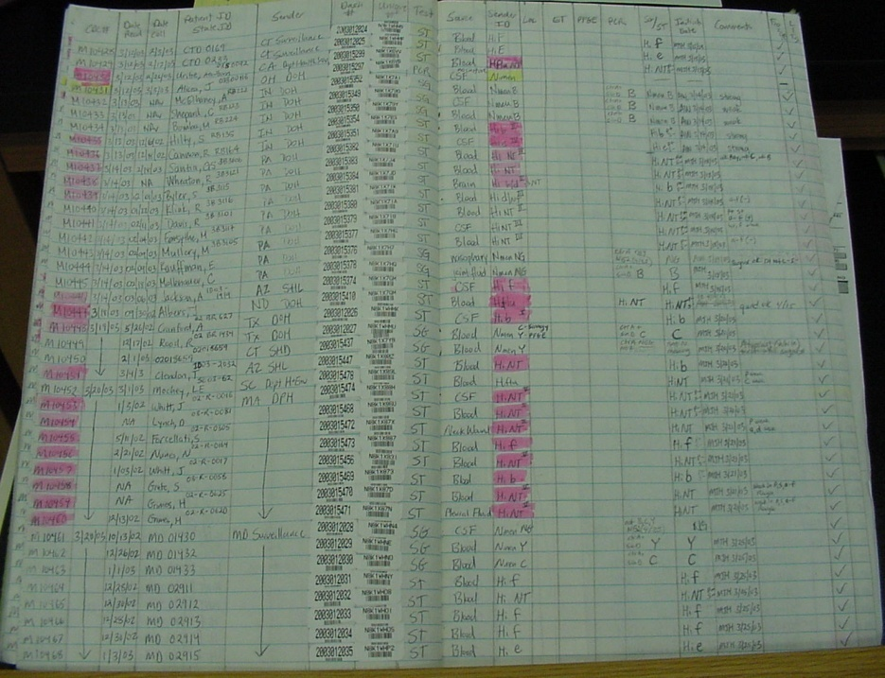

Information Security

Slide 49
Information Security
Protect sensitive information or data
Security plans Access controls
Agent inventories Storage
Written security policies / practices
Data access
Limited (official use only)
Restricted (classified)

Slide 50
Transport of Biological Agents
Movement of materials:
Internal (between laboratories or storage)
External (transfers or shipments)
Process maintains:
Control, Accountability & Containment
Documented records (chain-of-custody)

Slide 51
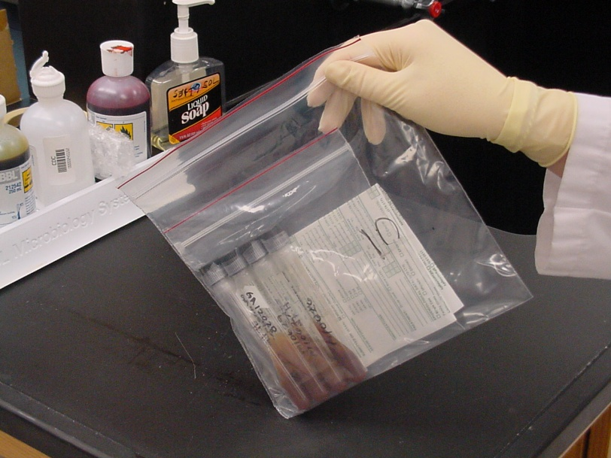
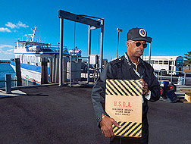
Transport of Biological Agents
Advance coordination
Communication
Authorization
Acknowledged receipt
Transport service
Trustworthy operations
Reliable personnel
Timely delivery

Slide 52
Transport of Biological Agents
Commercial shipping
Regulatory requirements
(DoT, Postal Svs, Air-ICAO/IATA)
Employee training
Packaging and Shipping requirements
Package hazard communication
Emergency contact

Slide 53
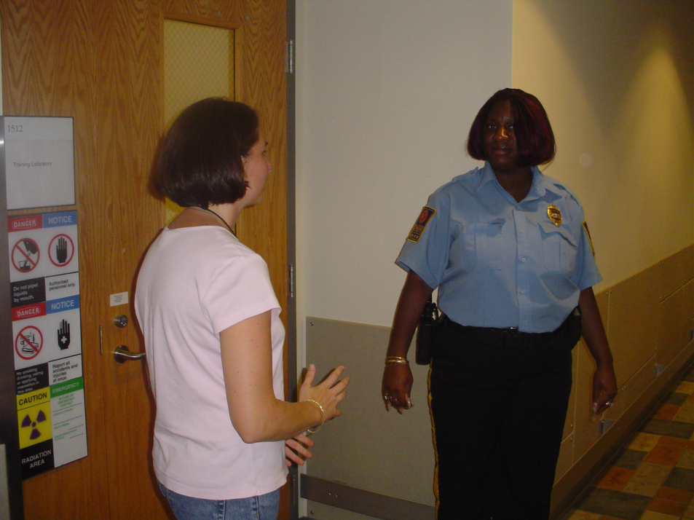
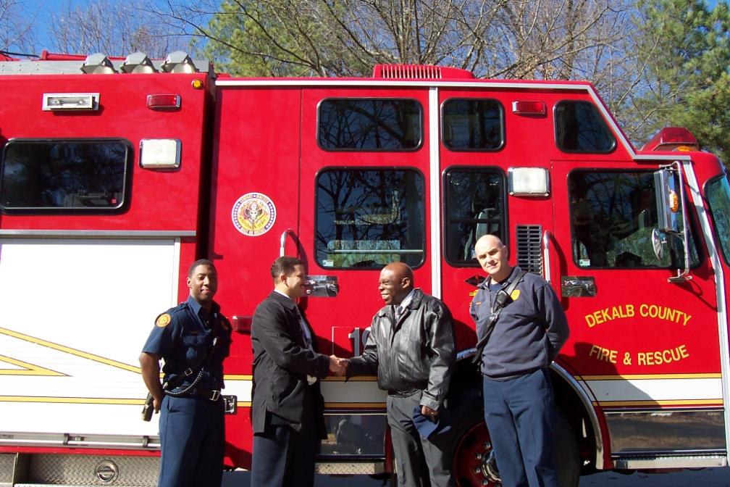
Accidents, Injuries, & Emergency Response

Slide 54
Accidents, Injuries, & Emergency Response
Advance coordination
Medical, Fire, Police, Maintenance Staff
Written response plans
Balances safety and security
Integrated with facility-wide plans
Types of events:
Medical events, Power outages
Fires, Natural disasters, Bomb threats

Slide 55
Reporting and Communication
Establish “Chain-of-Notification”
Involve: Public Relations & Legal Office
Establish roles & responsibilities
Develop written policies

Slide 56
Reporting and Communication
Internal reporting policies:
Exposures, accidents, other emergencies
Missing materials
Unauthorized personnel or entry
Local authority & Community notification
When, Who, How, Point-of-Contact

Slide 57

Training and Practice Drills
Required for all hazards
Strengthens emergency response
Enforces roles & responsibilities
Identifies program deficiencies
Facilitates advance resolution

Slide 58
Training and Practice Drills
Example Training Scenarios:
Management of hazards
Exposures, accidents, other emergencies
Missing materials
Unauthorized personnel or entry

Slide 59
Security Updates & Reevaluations
Annual review and update
After any biosecurity incident
Document the evaluation process
Comprehensive process:
Risk assessment process
Risk Statement
Biosecurity plan
Biosecurity systems

Slide 60
Developing a Security Program Summary
Institutional commitment
Collaborative input
Risk Assessment/ Risk Management
Implement comprehensive program
Reevaluate & Update

Slide 61
Barriers/Challenges to Implementing a Biosecurity Program
Resources
Management support
Resistance to change
Inadequate training
Insufficient information
Others?

Slide 62
Key Considerations
Understand what needs to be protected
Apply highest security to the most critical assets
Employ a graded security approach
Reduce risk to acceptable level
Obtain strong management support

Slide 63

Resources
WHO
Laboratory
Biosecurity Manual
WHO Laboratory Biosafety Manual - Third Edition
http://www.who.int/ihr/biosafety/publications/en/index.html
WHO Biorisk Management: laboratory biosecurity guidance, September 2006
http://www.who.int/ihr/biosafety/publications/en/index.html

Slide 64
Resources
Biosafety in Microbiological and Biomedical Laboratories (e-5th edition)
Section VII: Principles of Laboratory Biosecurity
http://www.cdc.gov/od/ohs/biosfty/bmbl5/bmbl5toc.htm
Laboratory Biosecurity-CD
New CDC training product
www.cdc.gov/od/ohs/biosafety

Slide 65
Thank You
Cristina Bressler
Office of Health and Safety
US Centers for Disease Control and Prevention
E-mail: Cbressler@cdc.gov

